Slide 1

Module 16 – SMA-X APM
Jan 2018
Notes:
[STANDARD SLIDE: L300 (animated)]
You can change out the photo with any image from Getty Images in DropBox.
If the main title is shorter, you can make the font larger.
You may have to move the title text around depending on the photo. Make sure the text is readable against the background photo.
You can change the background color for the rectangle in the bottom-right corner to look better against the background. Choose a Micro Focus color at 25% transparency.
=========================
Note to Narrator or Reader: [PRESS] indicates press the Page Down key to show the animation
=========================
Hello and Welcome to the [COURSE_NAME] Technical Overview Training, Level 300.
In this course you’ll gain a high-level understanding of the essentials of [PRODUCT_NAME].
[PRESS] If you want to download this presentation and save it on your own system, click the Tools & Help icon in the bottom-right corner of your window and select Download.
Or, if you want to access the PPT slides and speaker notes for future reference, go to the Attachments tab in your window click to download the presentation.

Slide 2
Objectives
After completing this module, you should be able to:
Describe the features of APM in SMA-X
Understand Applications, Road Maps, and Analysis
Understand the Optimization process

Slide 3
Application Portfolio Management

Slide 4
What is Application Portfolio Management (APM)
Definitions
Application Portfolio: A collection of software assets that help run an organization
Application Portfolio Management:
Application portfolio management (APM) is a framework for managing enterprise IT software applications and software-based services. APM provides managers with an inventory of the company's software applications and metrics to illustrate the business benefits of each application. (Source: http://whatis.techtarget.com/definition/application-portfolio-management-APM)
… [The attempt] to use the lessons of financial portfolio management to justify and measure the financial benefits of each application in comparison to the costs of the application's maintenance and operations. (Source: https://en.wikipedia.org/wiki/Application_portfolio_management)
APM = A framework or set of tools and policies

Slide 5
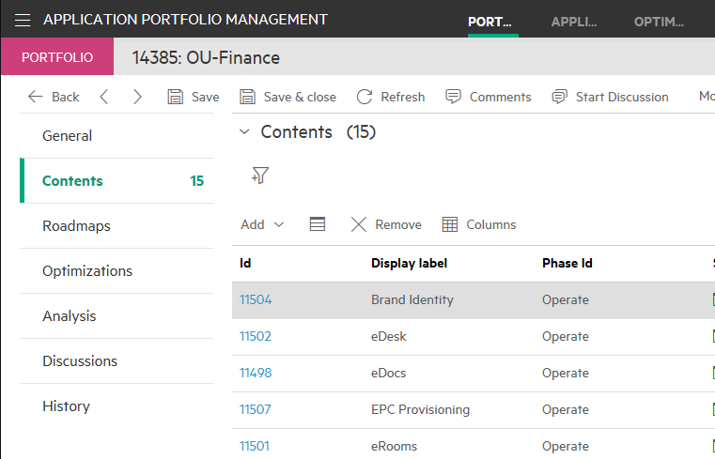
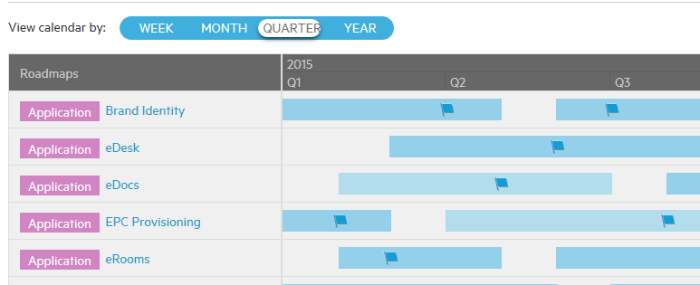
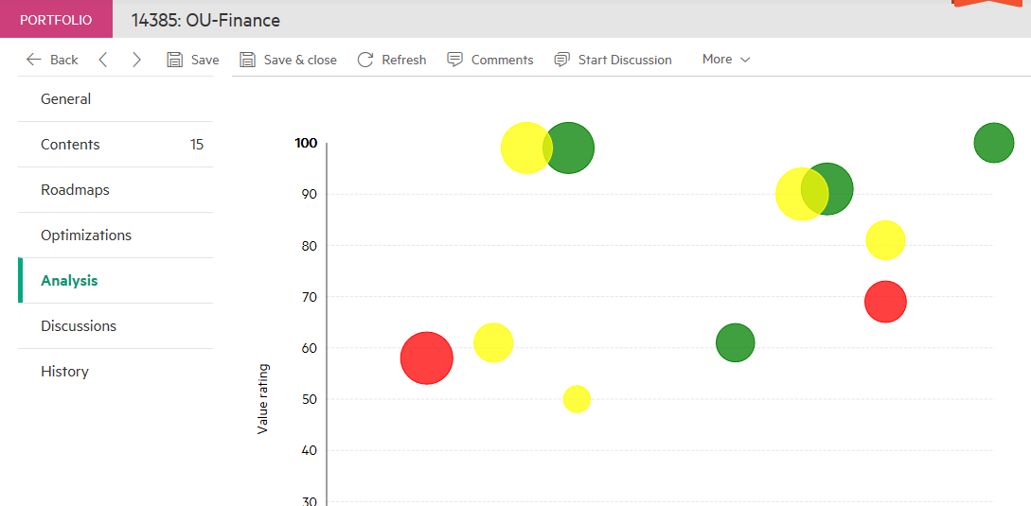
Application Portfolio Management
Managing the complete lifecycle of your services
Application Portfolio
Inventory of all your applications
Applications roadmaps
Provide a view into portfolio health
Portfolio Optimization
Application cloudification survey
Survey data collection
Optimization provides users with a quick way to identify the optimal cloud-based delivery model of an application within the target portfolio

Slide 6
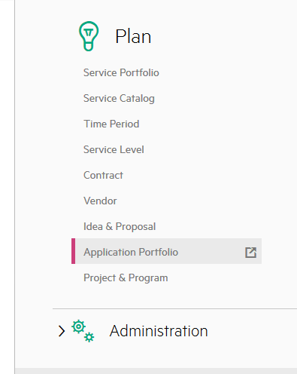
Menu > Application Portfolio
All configuration done in Application Portfolio
Four sub-areas
Portfolios
Applications
Optimizations
Optimization Types
Notes:
New menu option.
A portfolio is a collection of applications that have related initiatives, services, resources, projects, and programs.
An application is an investment of an IT company that implements a business process or function in your organization.
The Optimizations feature enables you to optimize portfolios and select the suitable cloud delivery model that suits your organization's needs.
Each optimization record is associated with a optimization type. The optimization type defines the algorithm logic and directs how the optimization result is calculated. Currently, Application cloudification is the only optimization type supported.

Slide 7
Application Portfolio Management: Applications

Slide 8
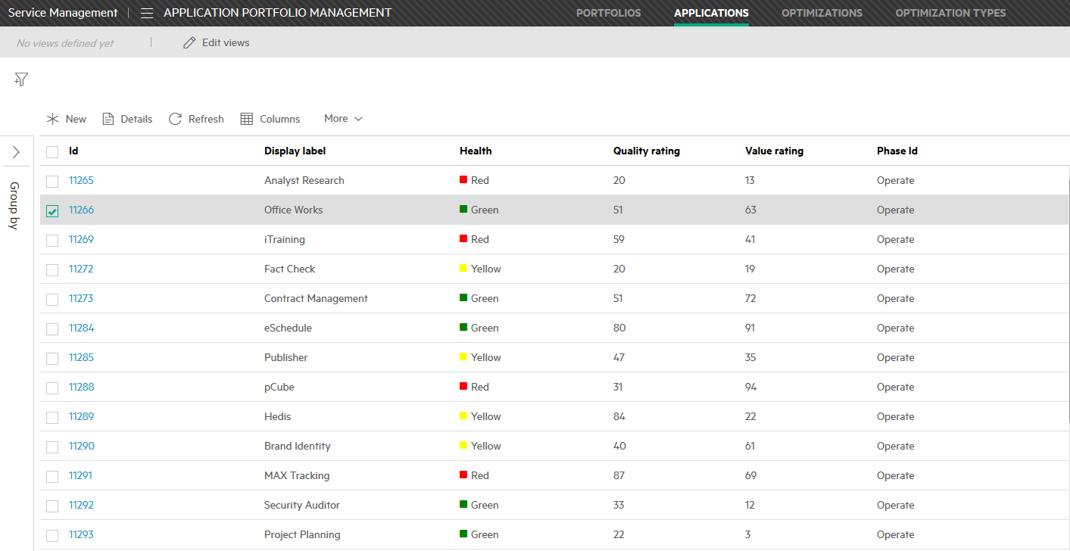
Application list
An Application is the basic entity for APM
Applications support a portfolio or portfolios
Notes:
An application is a basic unit for application portfolio management. Each application is inventoried and attributes assigned.
An application can be made up of one or more actual services and supports a portfolio or portfolios and has its business value defined.

Slide 9
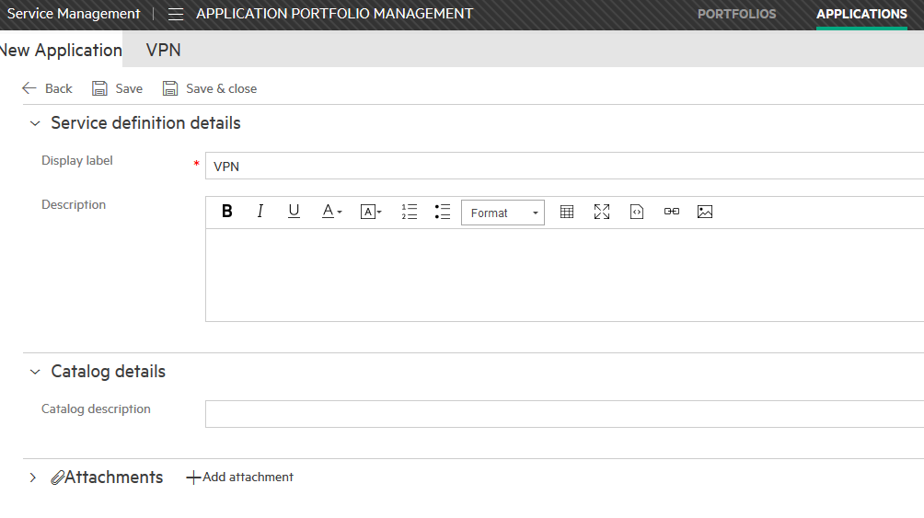
New application definition
Each application has a workflow
Each application can have one or more roadmaps
Notes:
New application creation screen. Best to click “Save” so that you are returned to the full details of the newly created application and can then define know attributes.
Uses New ServiceDefinition form

Slide 10
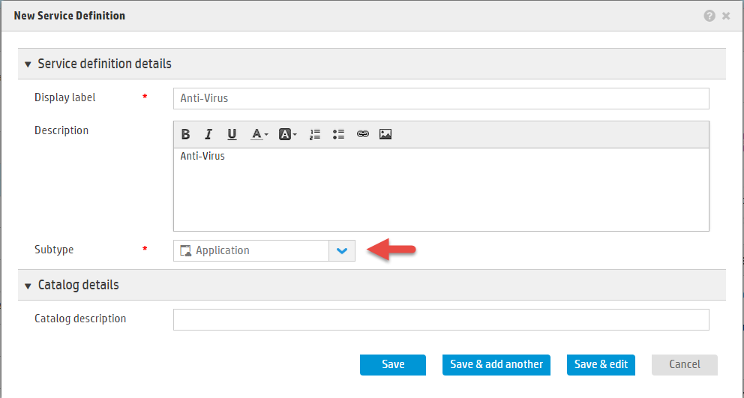
Creating an application from Service Management
Menu > Service Catalog > Service Definitions
Notes:
Must edit “Subtype” field

Slide 11
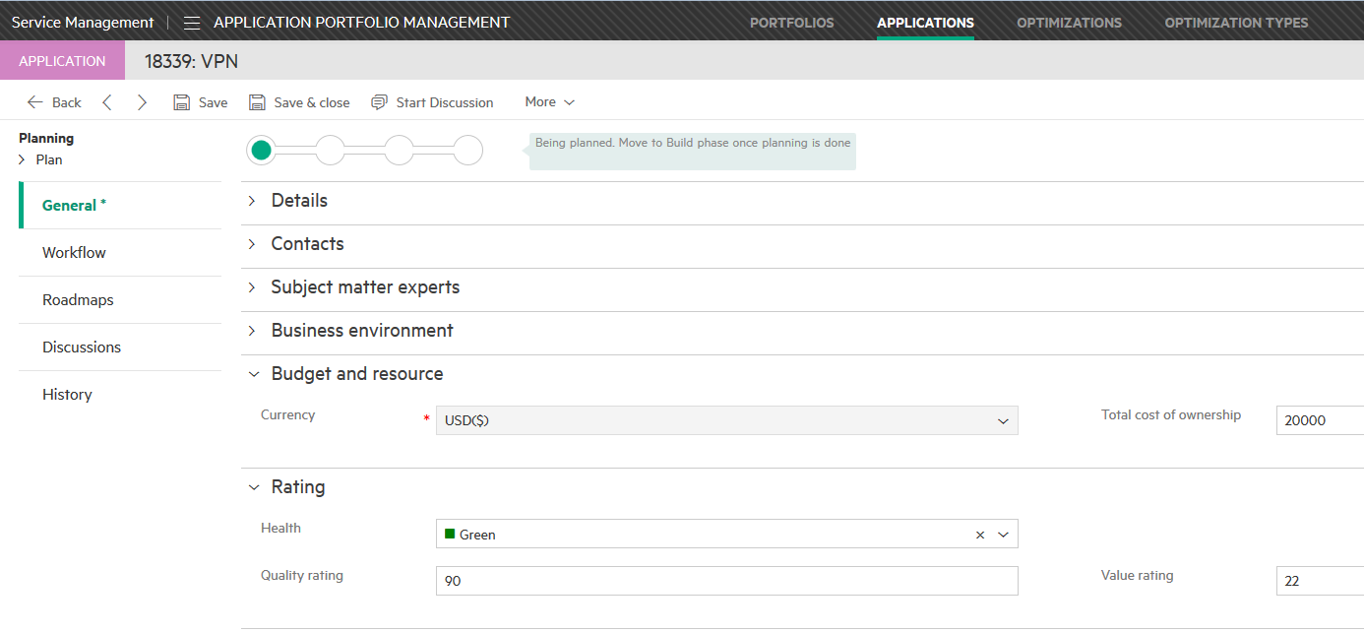
Application attributes
Critical info for analysis
Certain attributes are necessary for analysis and optimization
Owner
Total Cost of Ownership
Health
Quality rating
Value rating
Notes:
Some attributes are critical for other functions in Application Portfolio Management.
Owner is needed for surveys.
The attributes listed below are all used in the analysis of applications in a portfolio.
Total Cost of Ownership
Health
Quality rating
Value rating
Uses Full ServiceDefinition form

Slide 12
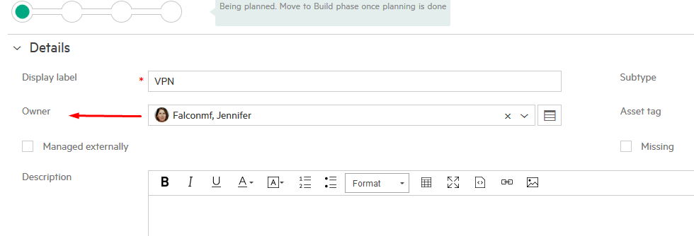
Application attributes
Critical information for surveys
Application owner answers all application surveys. Application owner must be ESS user.
Notes:
The application owner field (Label: Owner) is vital for the optimization process. All application surveys in an optimization are sent to the application owner.
An application owner must be a ESS portal user. This means they must be created as a User not a Contact.

Slide 13
Application Portfolio Management: Roadmaps

Slide 14
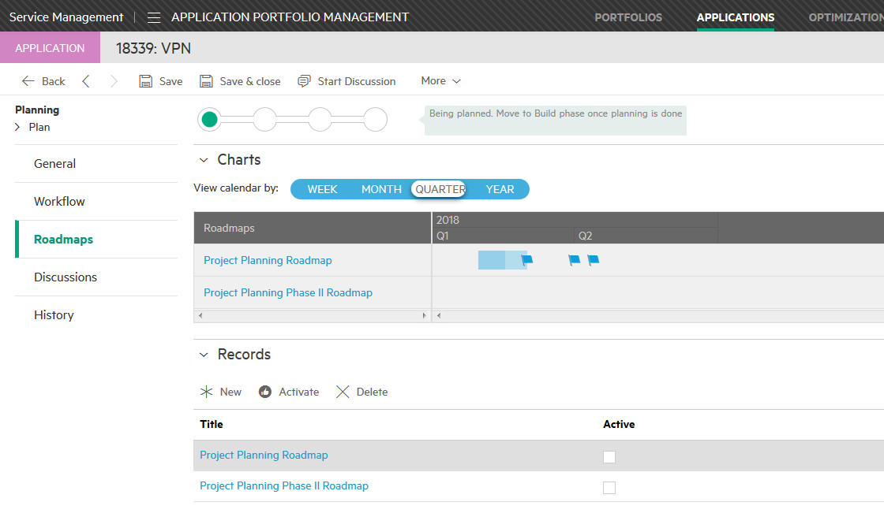
Roadmaps
High level, future plan for an application
Can only have one active roadmap
Create new roadmap record
Create phase(s)
Create milestone(s)
Milestone
Roadmap list
Phase
Notes:
Roadmaps provide documentation concerning future plans for an application
Define roadmap
Add Phases
Add milestones

Slide 15
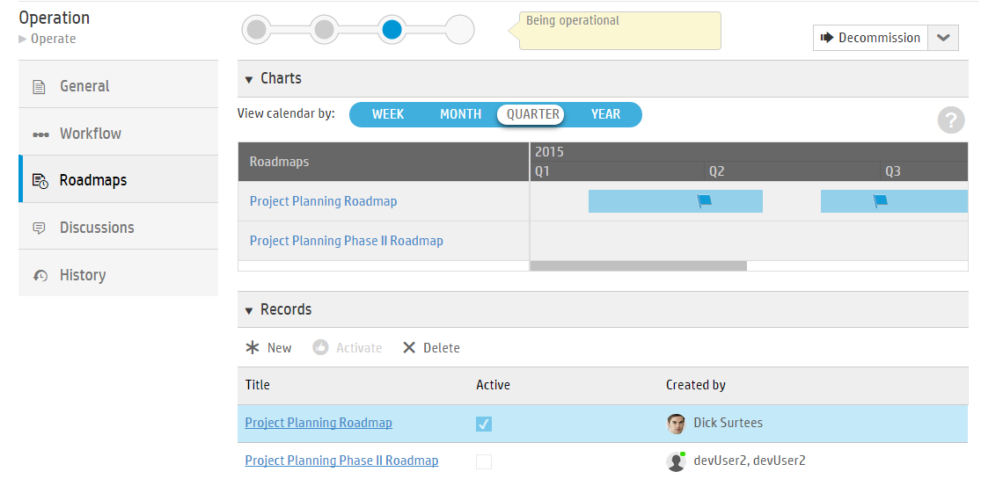
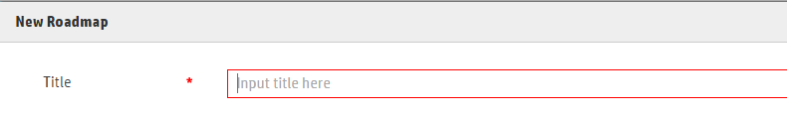
Creating a new roadmap
Click “New”
Provide a name
Click on new roadmap in list to create phases and milestones
Click “New”
Roadmap title

Slide 16
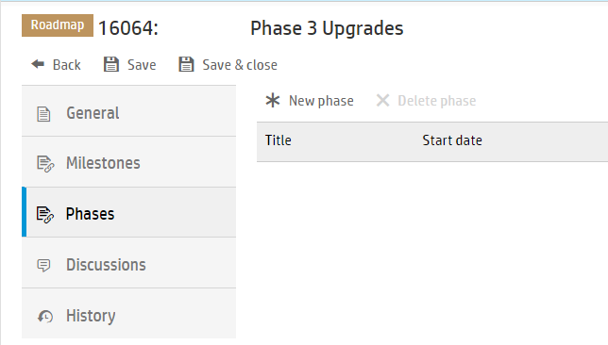
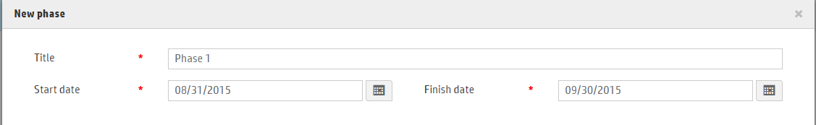
Roadmap phases
Roadmap name
A span of time for accomplishing some work
New phase
Represented by a blue bar on the roadmap chart
Define one or more phases for the roadmap
Requires title, start date and finish date
Phase definition window

Slide 17
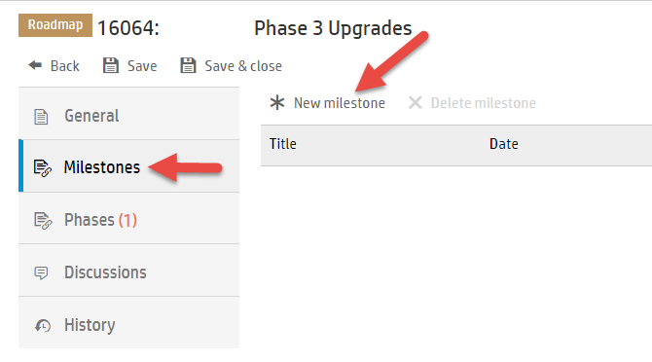
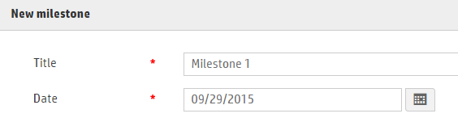
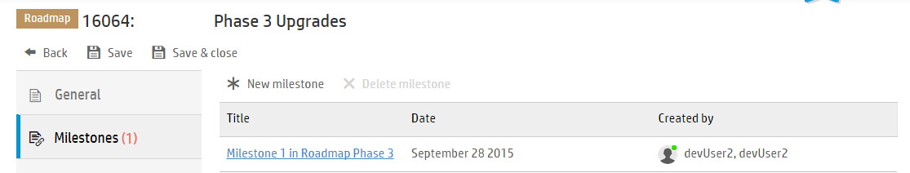
Roadmap milestones
Significant events within a phase of a roadmap
Represented by a flag on roadmap chart
Required fields are milestone title and date for achievement
A milestone should occur within a phase
Required fields
Milestone list entry

Slide 18
Application Portfolio Management: Portfolios
Notes:
A portfolio is a collection of applications that have related initiatives, services, resources, projects, and programs. A portfolio can attain wide reaching benefits and impact. The collection of applications in an IT portfolio is more business oriented than technical.

Slide 19
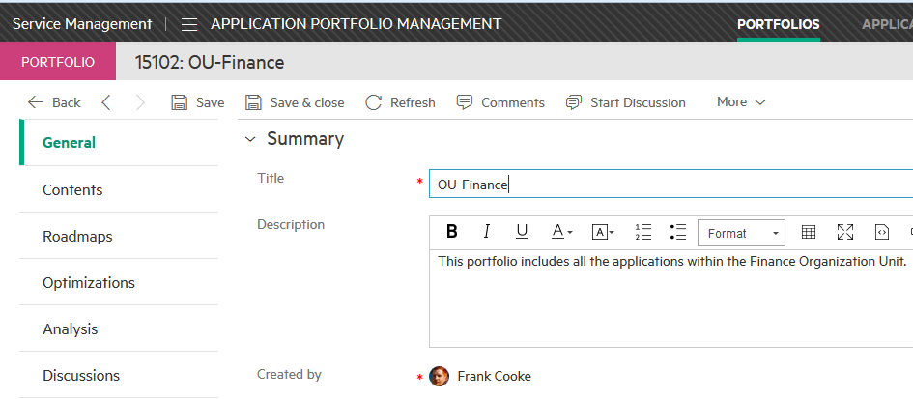
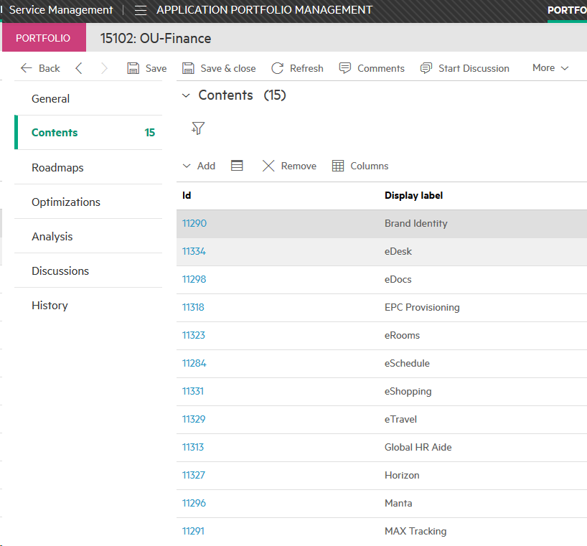
Application portfolio
A portfolio is a collection of related applications

Slide 20
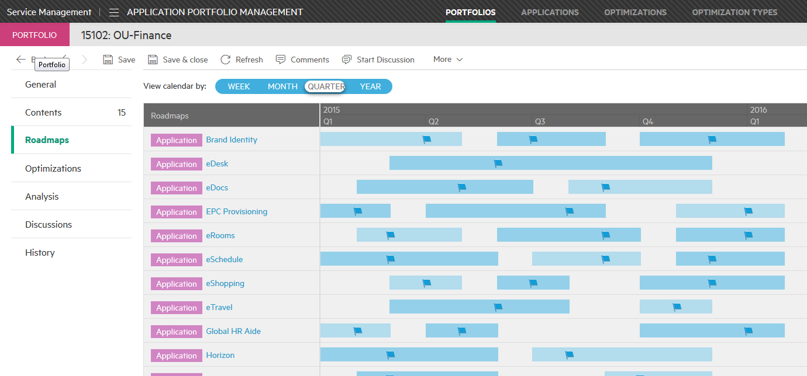
Portfolio applications active roadmaps
Active roadmap for each member application shows major application activity
Notes:
Provides a high level view of what activity is planned for each application and how the activities for the different applications overlap.

Slide 21
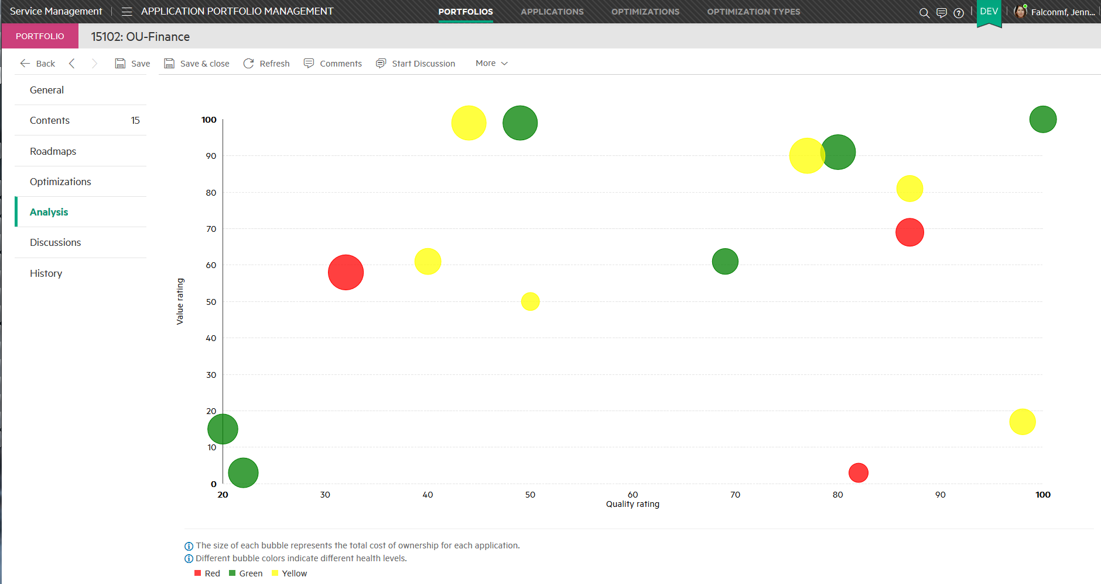
Portfolio analysis
Provides a view into portfolio health
Mouse-over
Value rating
Quality rating
Notes:
Data comes from Application record
Size of bubble = TCO (Total Cost of Ownership)
Color = Application health
Red = Risks identified that may have adverse impact
Yellow = Issues identified, but being managed
Green = No issues exist
Quality Rating = a number from 0 to 100 where 100 indicates the highest quality and 0 (zero) indicates the lowest quality.
Value Rating = A number from 0 to 100 where 100 indicates the highest vale and 0 (zero) indicates the lowest value.
8/12/2015: Received email from documentation developer & documentation is incorrect. Correct language is shown above. Documentation will be updated. No ETA for update.

Slide 22
Application Portfolio Management: Survey
Notes:
A pre-defined survey is provided for you to collect basic information of each application from the application owners. This feature assesses and analyzes the survey feedback and displays the findings as a graphical report. The assessment is intended to provide preliminary guidance as to fitness both from a business and a technical point of view and to provide recommendations for transforming the application to the cloud platform. The application portfolio owner can then create a proposal based on the report to implement the delivery model transformation.

Slide 23
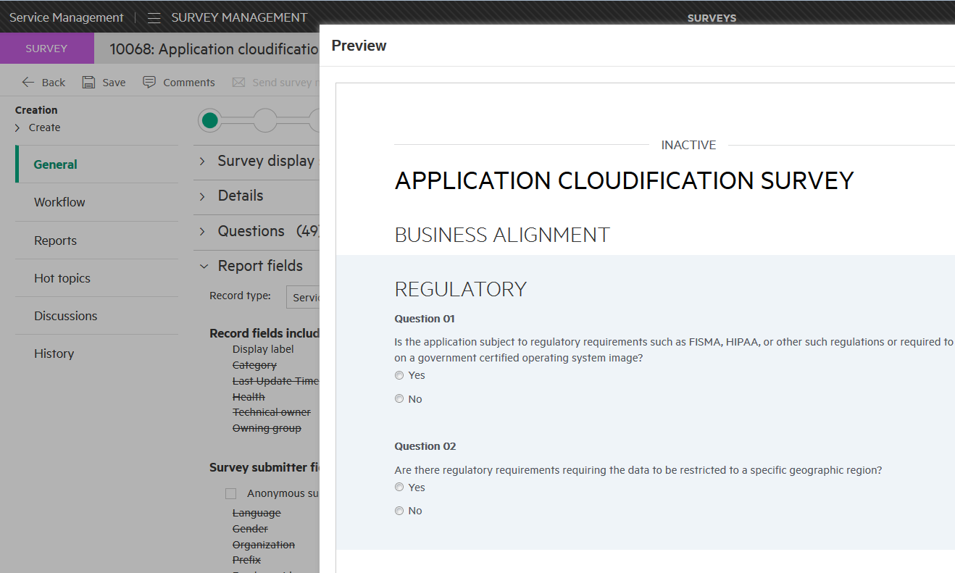
Surveys are sent as part of an Optimization workflow
OOTB Survey found in Menu > Build > Survey > Application cloudification survey
Built on existing survey capability
Surveys are sent to application owners
Optimization workflow step – “Send survey”
Survey responses are basis for “Information Quality” metrics
When Optimization workflow moves to “Send Survey” phase OOTB survey gets copied and sent
Notes:
Application Owner is the role that responds to surveys.
The application cloudification survey contains a total of 12 sections with 35 questions. Questions are designed to gather basic information of an application, so that the system can analyze the application’s business and technical suitability of cloud solution.

Slide 24
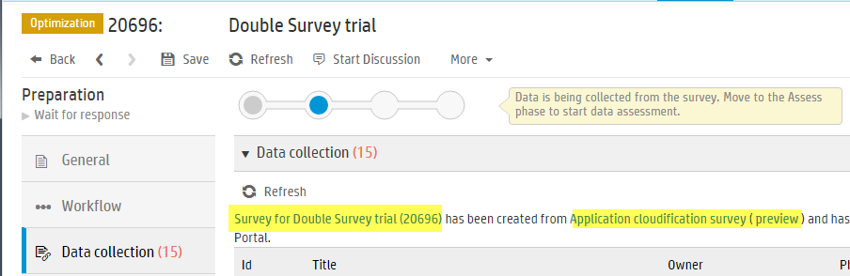
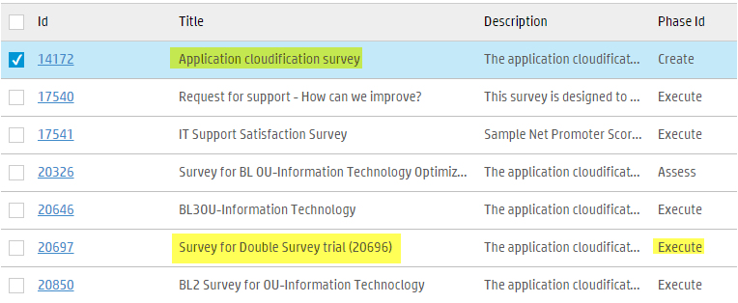
Optimization data collection
OOTB Survey template
Survey name
Survey list
Auto-created survey

Slide 25
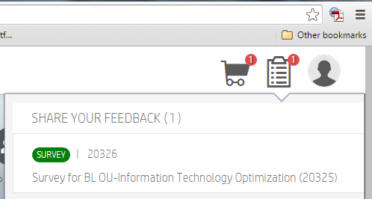
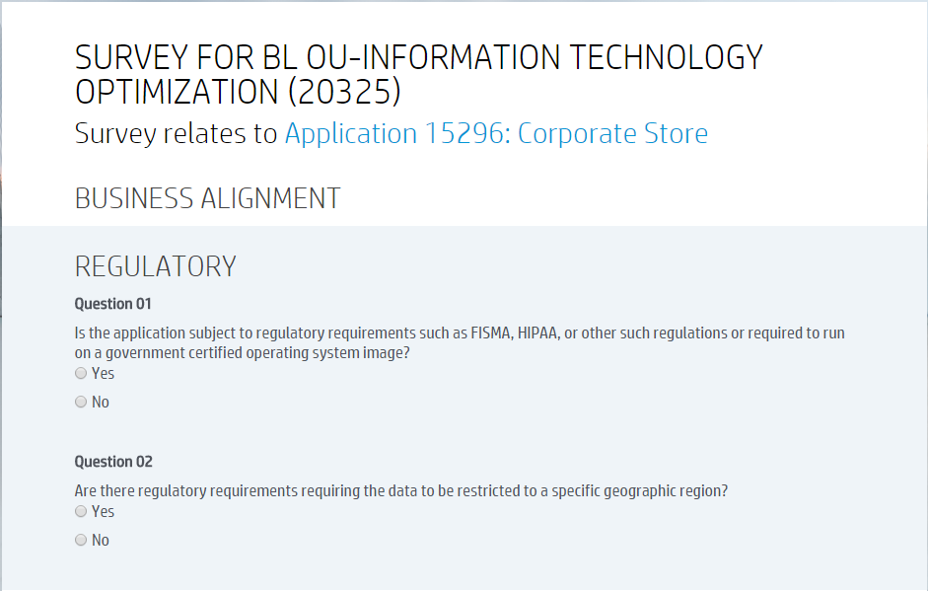
ESS Portal view of survey

Slide 26
Application Portfolio Management: Optimization types
Notes:
Each optimization record is associated with a optimization type. The optimization type defines the algorithm logic and directs how the optimization result is calculated.

Slide 27
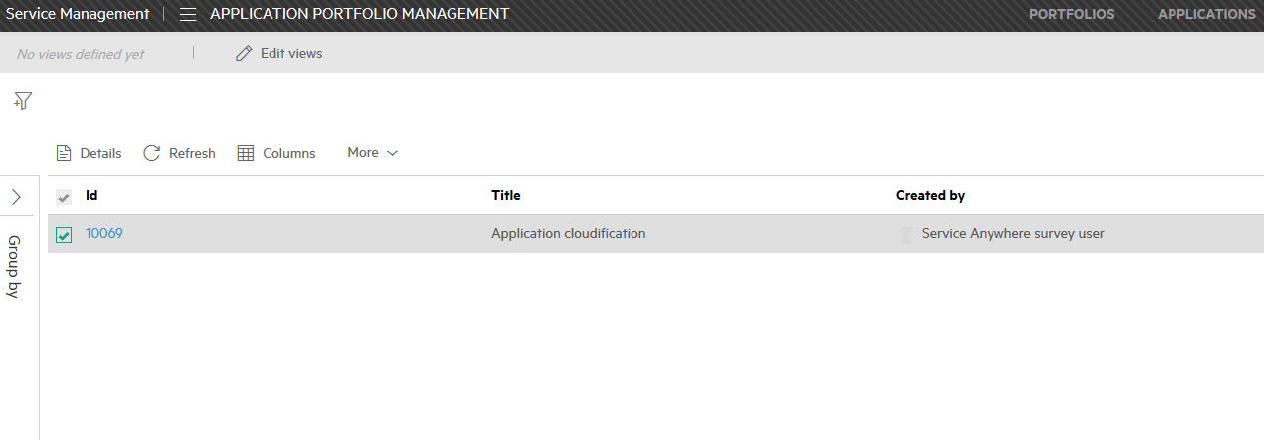
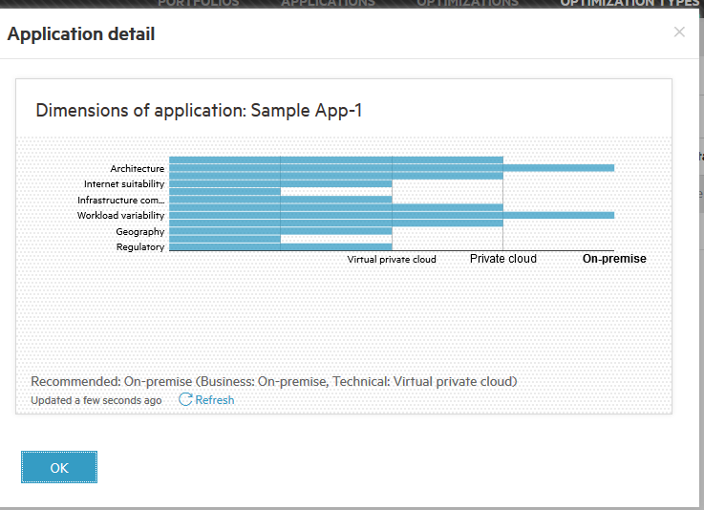
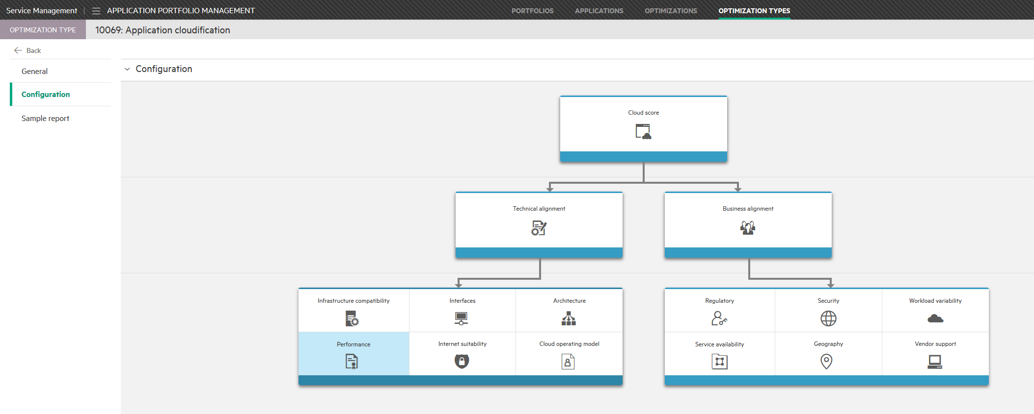
Application optimization type
Only one exists in current release – Application cloudification
Based on surveys sent to application owners
Working only on Application portfolios
Outcome is a scorecard based on business and technical suitability suggesting the best place for the application:
On-premise
Private cloud
Virtual private cloud
Public Cloud

Slide 28
Application Portfolio Management: Optimization
Notes:
The Optimizations feature enables you to optimize portfolios and select the suitable cloud delivery model that suits your company's needs. This feature allows you to optimize your application portfolios by providing preliminary guidance for each application.
The optimization report is not intended to provide a definitive answer as to whether this application should or should not move to the cloud. It is intended to provide potential cloud suitability from a business and a technical point of view.

Slide 29
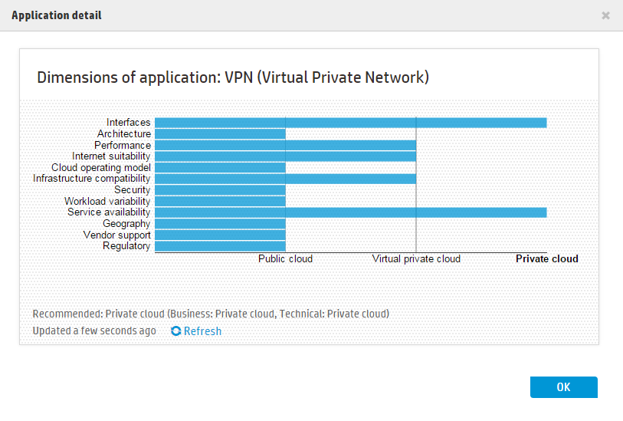
Optimization process
Menu > Plan > Application Portfolio > Optimizations
Create a new optimization
Send survey to application owners
Select an email template
Establish a due date
Move optimization record to Assess phase of workflow
View optimization report
Application survey results
Notes:
Once surveys are sent the workflow automatically moves to the “Wait for response” phase.
All survey respondents must be a Self Service Portal user. None of the existing application owners are “users” in SAW so they cannot log in and cannot respond to a survey. During a demo you will need to assign yourself as the owner of at least one application. If you assign yourself to more than one application, fill out all but one of the survey’s before the demo.

Slide 30
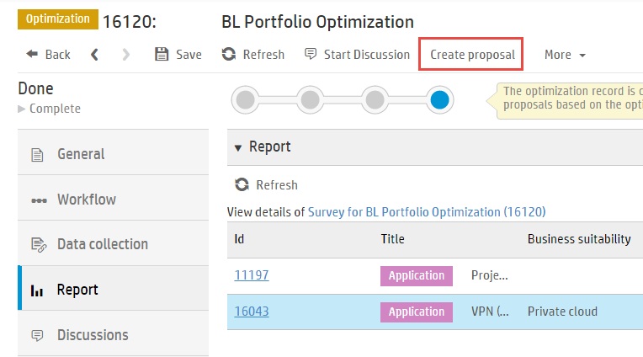
Completed optimization
Can create a proposal from completed optimization

Slide 31
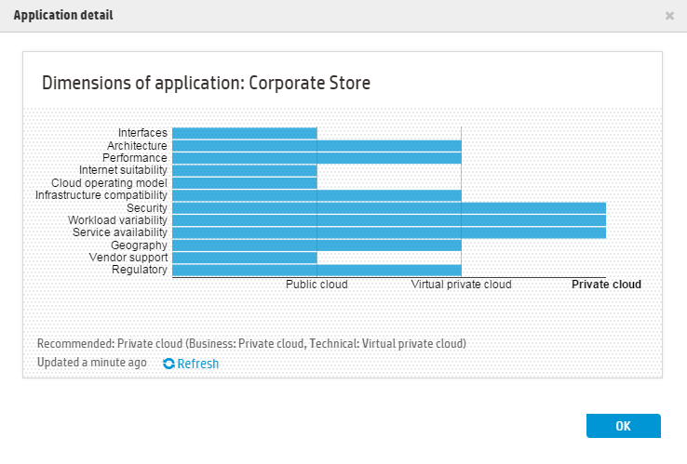
Optimization report – per application
Based on application owner survey response
Dimensions cannot be changed
An information quality score is provided based on the number of questions answered
Intention is only to provide potential suitability for cloud deployment
Not intended as in depth analysis
Notes:
It is important to understand that the assessments made are based on the current broad risk and appetite parameters that are aligned to keeping regulated applications and sensitive data within the
data-center environment.

Slide 32


Lab Exercises
Practice APM demo card

